Slide 1
ALADIN
Assessment and Solution (hint) Generator Destined for Informatics and Neighbouring Domains

Slide 2
https://toniobarton.wordpress.com/2018/08/21/make-it-stick-book-study/ https://www.sec-ed.co.uk/content/best-practice/a-teacher-s-guide-to-retrieval-practice-feedback-and-elaboration/

Slide 3
http://webcache.googleusercontent.com/search?q=cache:https://medium.com/the-ascent/evidence-based-strategies-to-better-remember-what-you-learn-c7e6d8136d3d&sca_esv=573120737&strip=1&vwsrc=0
Retrieval:
Retrieval strengthens the memory and interrupts forgetting.
While any kind of retrieval practice generally benefits learning, the implication seems to be that where more cognitive effort is required for retrieval, greater retention results.
Spacing:
Spaced practice, which allows some forgetting to occur between sessions, strengthens both the learning and the cues and routes for fast retrieval.
learning works best when it feels hard.
interleaving,
variation,
reflection,
elaboration

Slide 4
Starting point
a)
Scalability: One author creates one Assessment-Item in a standard
Assessment-Validity: (Is the thing we want to test, actually tested?) Expressiveness of „Assessment-Item-Types“ → MC, cloze, image correlation, etc. (ca. 20 interaction-types in QTI [1]) – perhaps insufficient?
Automatic scoring: Expressiveness of the inbuilt scoring-methods: Standard is too restrictive → Often leads to customized development on a closed source tool (and therefore to „Lock-In“-effects)
Assessment-Platform
a)
Standard
b)
Authoring System
Assessment-Item
Author
b)
Execution Engine
c)
Assessment-Item
Score
c)
Presen-tation
Learner
[1] IMS QTI Interactions - http://www.imsglobal.org/question/qtiv2p2/QTIv2p2-ASI-InformationModelv1p0/imsqtiv2p2_asi_v1p0_InfoModelv1p0.html#Data_ChoiceInteraction
Notes:
QTI-Standard unterstützt ca. 20 Interaktionen (http://www.imsglobal.org/question/qtiv2p2/QTIv2p2-ASI-InformationModelv1p0/imsqtiv2p2_asi_v1p0_InfoModelv1p0.html#Data_ChoiceInteraction)
(Grundziel des Standards der „Austauschbarkeit“ verletzt)

Slide 5
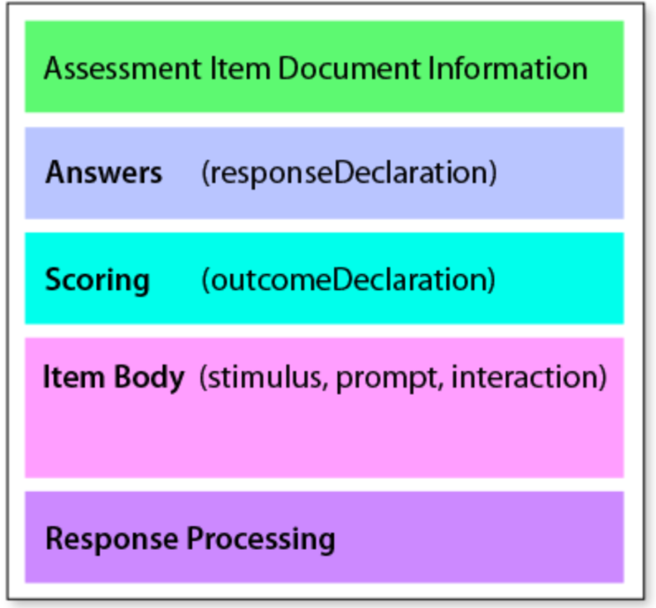
Restructuring of Assessment-Items
Assessment-Item (QTI) [2]
Assessment-Item-Data
Interaction-pool
Scoring function
[2] IMS QTI Item-Structure - https://www.imsglobal.org/spec/qti/v3p0/guide#h.w7rp6is7v7fd

Slide 6
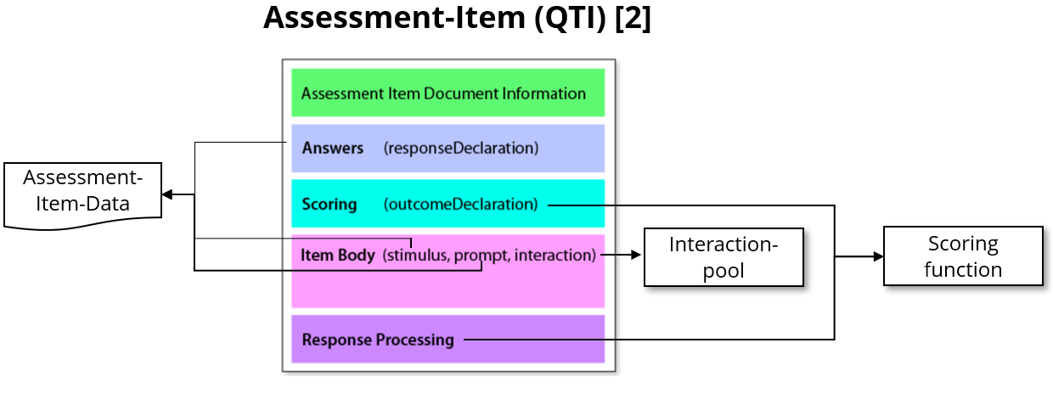
OPALADIN - conceptual overview
Author
OPALADIN
Generator- and Scoring- configuration
Interaction-configuration
ALADIN
CARPET
Automatic Item Generation (AIG)
Execution Engine
Assessment-Generator
Assessment-Item-Data
LLMs
Data Generators
Assessment-Item
Graph Rewriting
…
…
Generator-parameters
Scoring function
Score
Solution attempt
Presen-tation
Learner

Slide 7
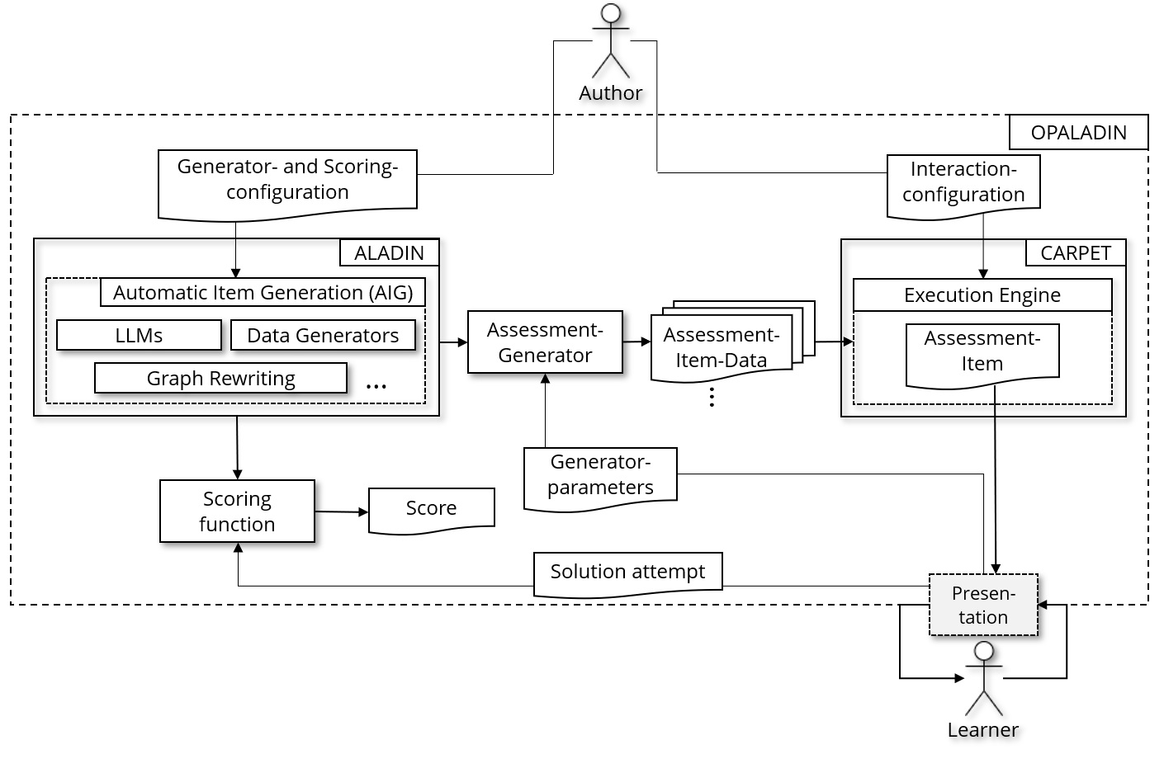
Comparison
Assessment-Platform
a)
Standard
b)
Authoring System
Assessment-Item
a)
Autor
b)
Execution Engine
Assessment-Item
Score
c)
c)
Presen-tation
a)
Scalability
b)
Assessment-Validity
c)
Automatic Scoring
Learner

Slide 8
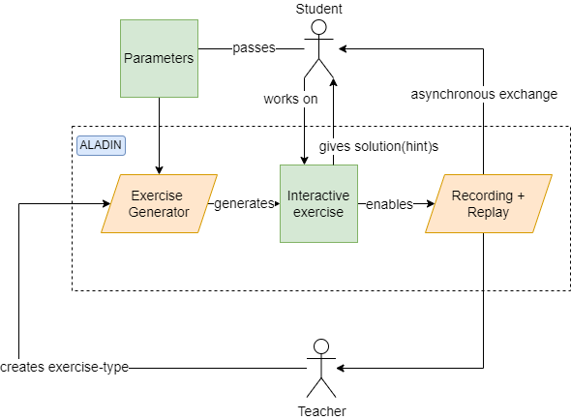
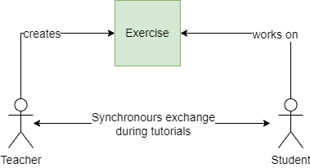
Learning/Teaching scenarios with and without ALADIN
Scenario without ALADIN
Scenario with ALADIN

Slide 9
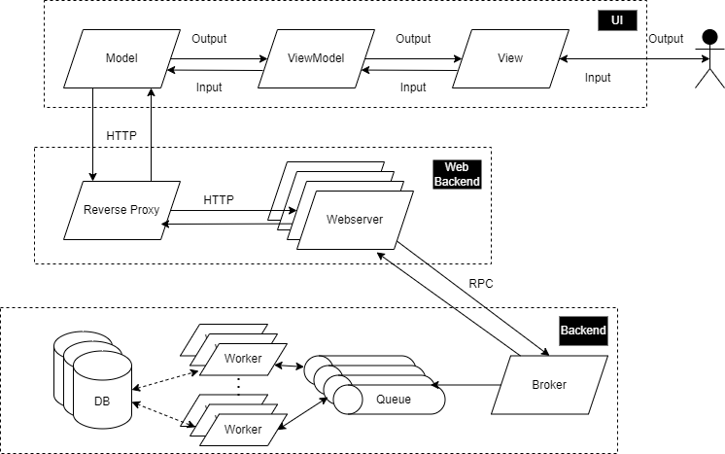
Software architecture of ALADIN

Slide 10
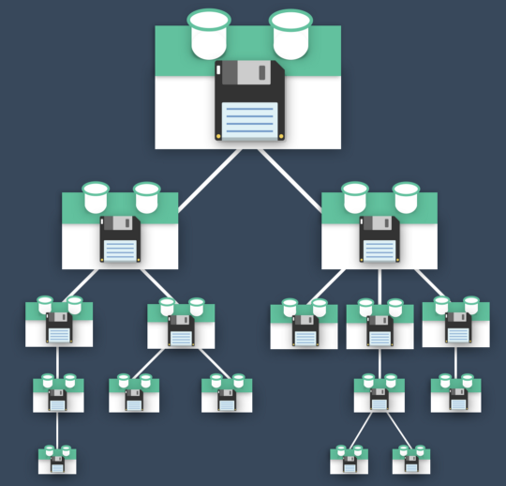
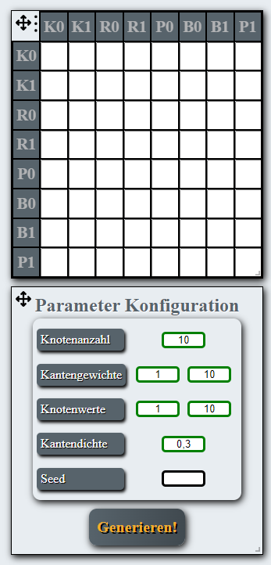
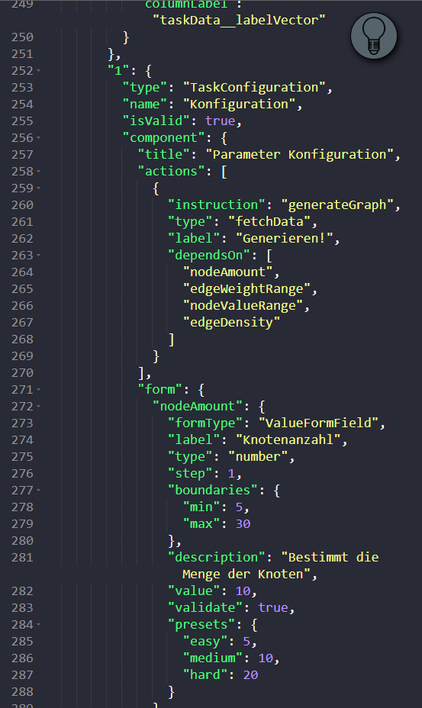
Behind the scenes
Validation
1.
2.
1.
…
3.
…
5.
4.
2.
3.
4.
5.
Enables:
„Atomic“:
handling of student errors
provision of hints
4R-Principle:
Record, Redirect, Replay, Resume

Slide 11



Example-Assessment: Process-Modeling
Assessment-Subject
Model syntax
Model semantics
Subject semantics
Model elements and construction rules
Learning Goal / Interaction :
Factual knowledge
Detection of syntax errors
Meaning of the model elements and construction rules
Learning Goal / Interaction:
Extension of models
Detection of semantic errors
Modeling of realworld scenarios
Learning Goal / Interaction:
Model-translation: Natural Language <-> Model

Slide 12
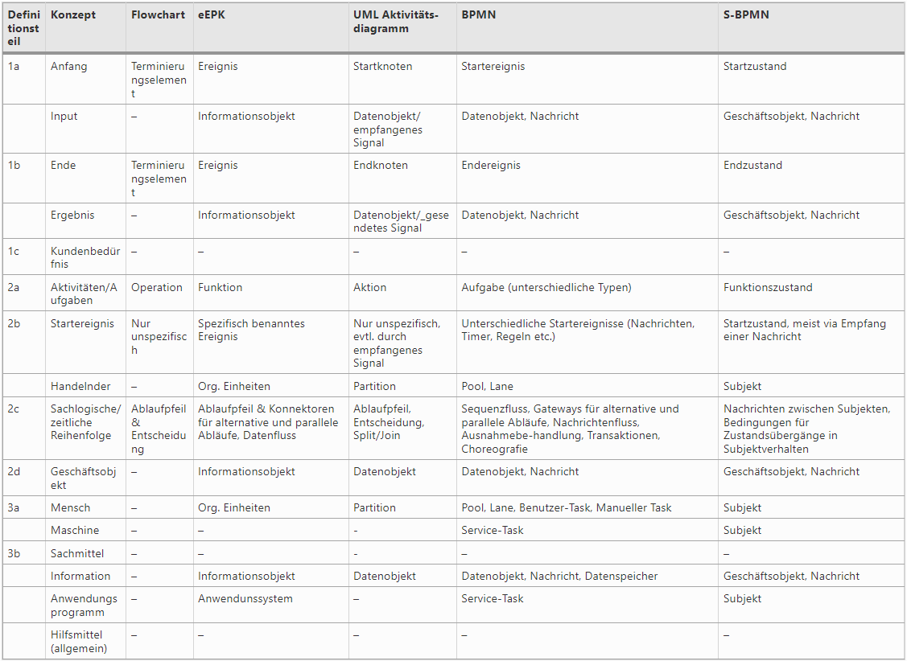
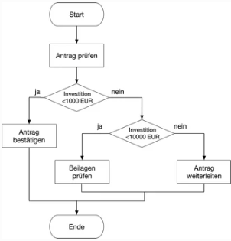
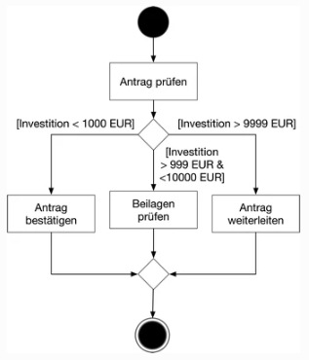
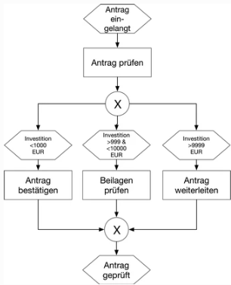
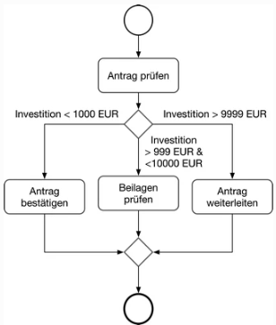

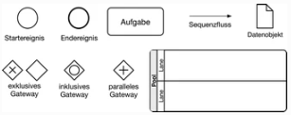
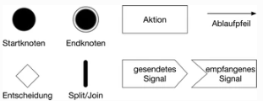
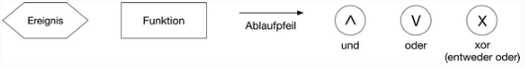
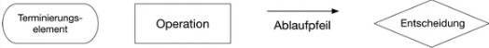
Example-Assessment: Process Modeling
…
BPMN
EPK
UML
Flowchart
Subject semantics
Meta-model
Model semantics
Model syntax

Slide 13
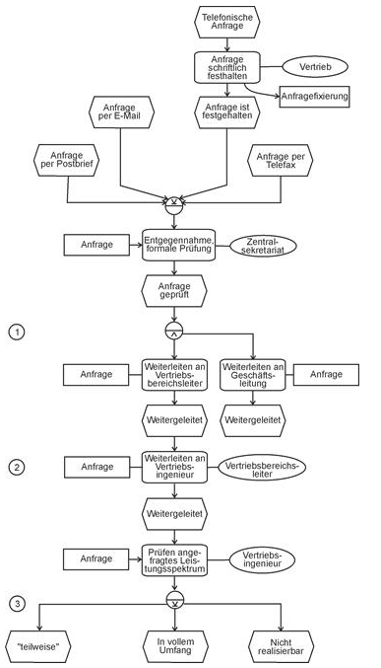
Example-Assessment: Process Modeling
Exercise definition: Model an event-driven process chain that represents the business process described in the text.
Natural language description:
The business process is started on the basis of a customer inquiry. This can be received by mail, fax, e-mail or telephone. If it is received by phone, the sales department prepares a written document that records the request (request fixation). Regardless of the type of receipt, the central secretariat receives the request, checks it for formal correctness and then forwards it to the responsible sales area manager and the management.
The sales area manager passes the request on to one of his sales engineers, who checks the feasibility of the offer. This initially concerns the requested range of services. If this is not within the company's range of services, a rejection will be made. If only parts of the requested services can be provided, partner companies are asked for support and involved either as cooperation partners or subcontractors. If no suitable partners are found, the request is rejected.

Slide 14
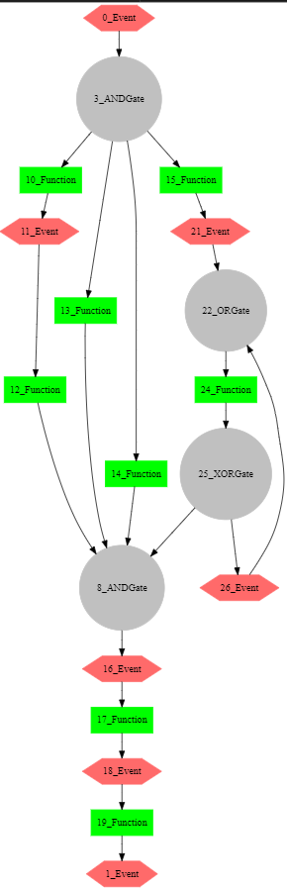
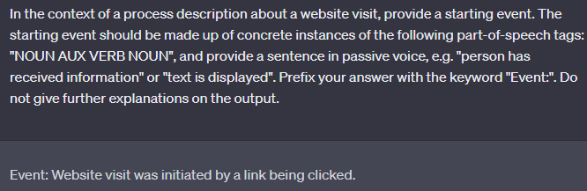
Example-Assessment: Process Modeling
ALADIN generates a random process, via a user-defined „graph-grammar“ and a graph-rewriting-engine
ALADIN generates labels for the process elements, via user-defined prompt-templates and a LLM
ALADIN generates a natural language process description, via user-defined text-templates
The process starts, as soon as the Website visit was initiated by a link being clicked.
The process splits into 4 parallel subprocesses: User authentication, Page loading, Content retrieval, Data tracking.
The subprocess "User authentication" starts with verifiying user credentials, then the User's provided information is checked and finally granting access to the website.
….

Slide 15
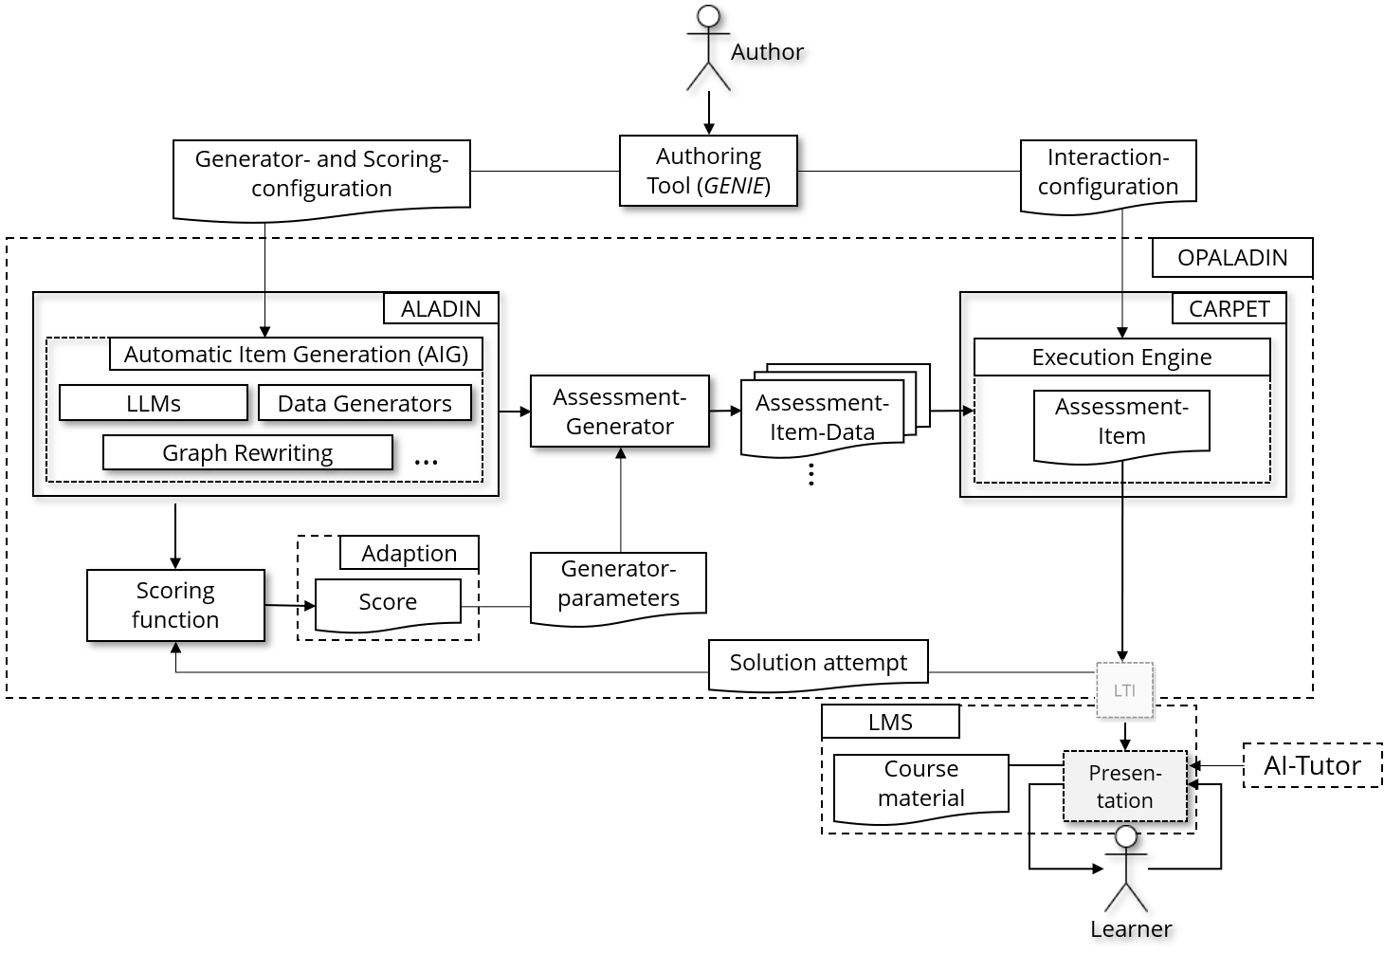
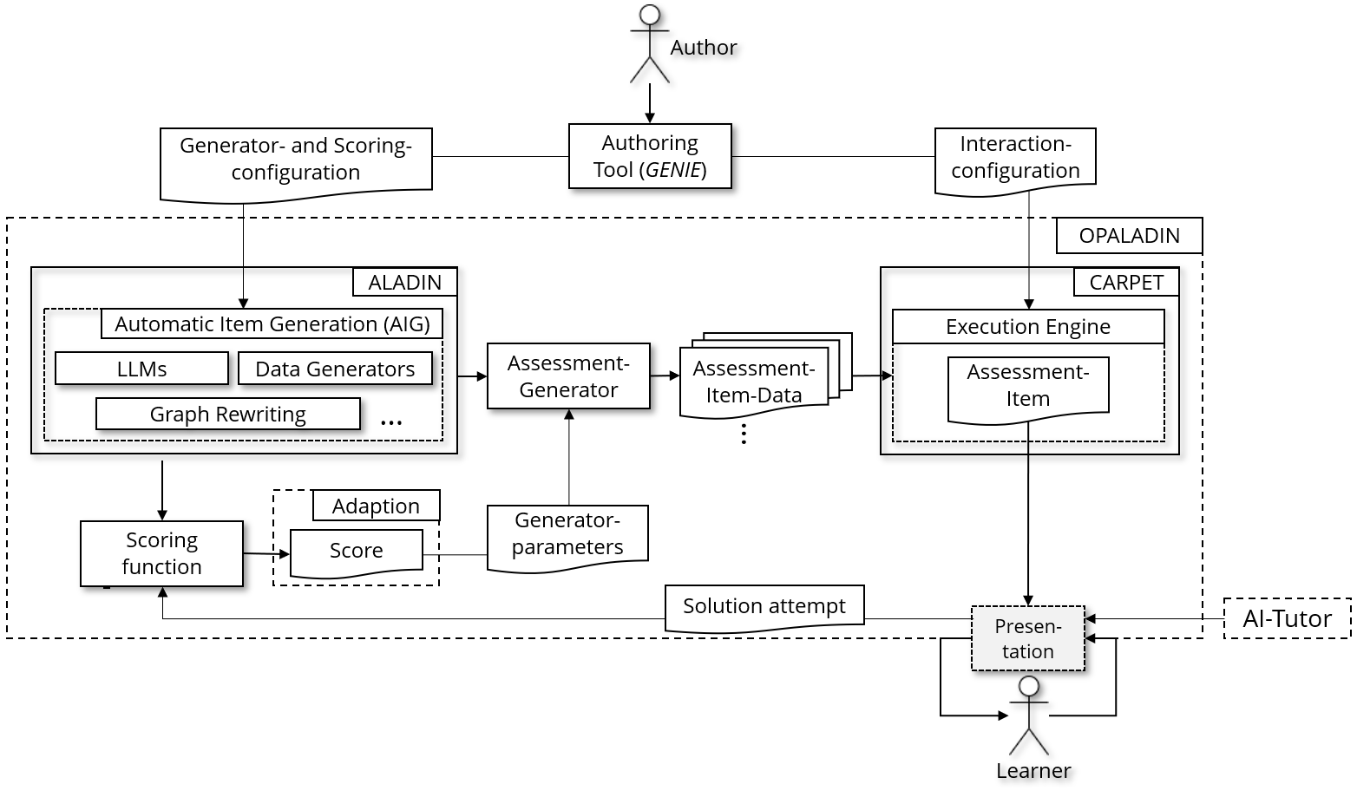
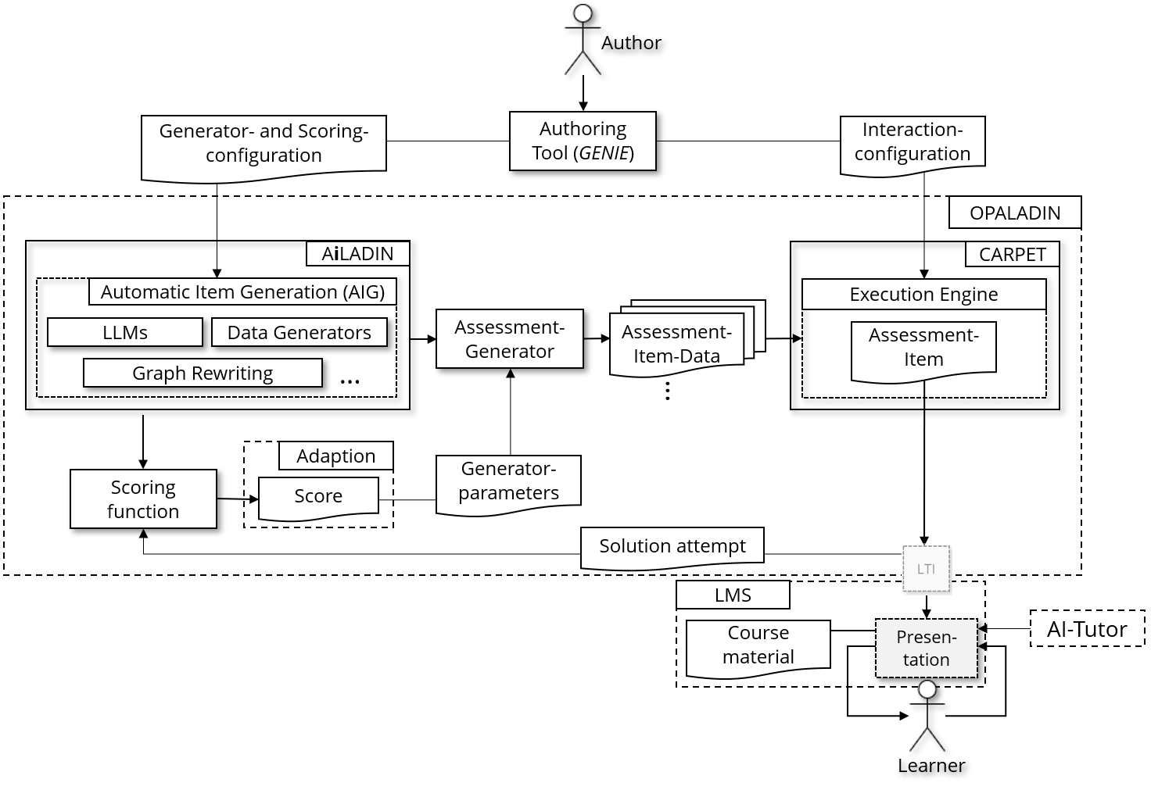
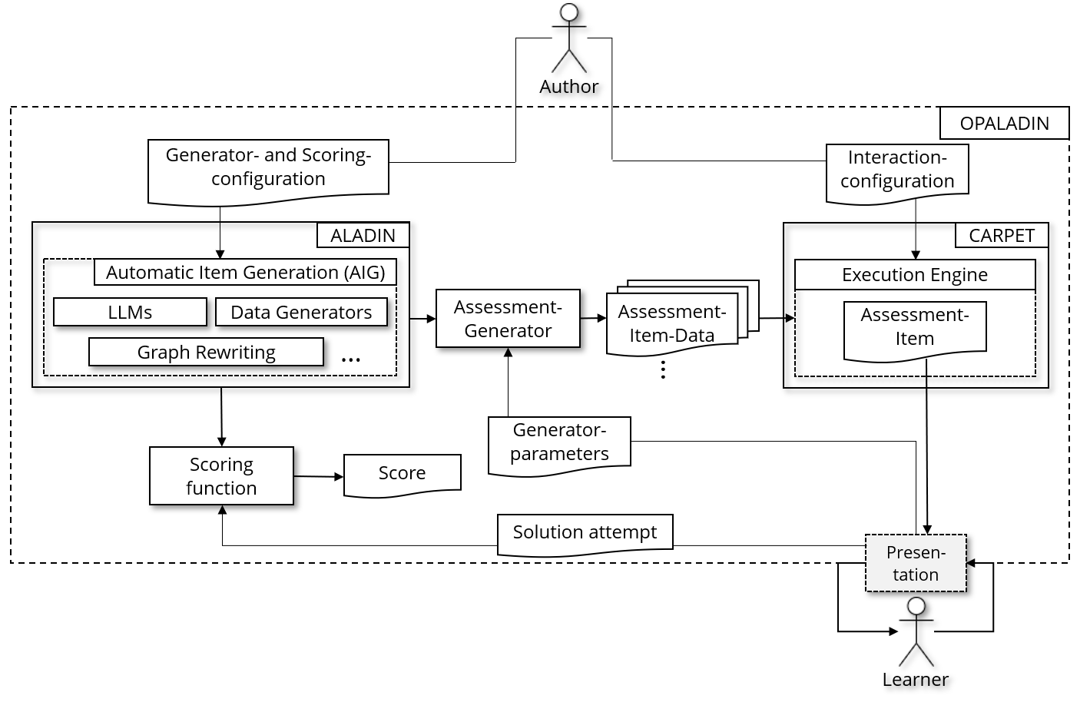
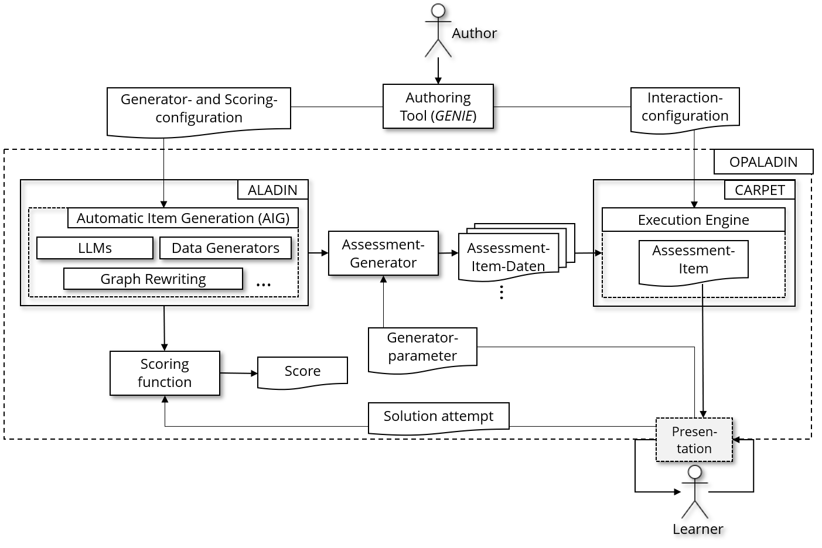
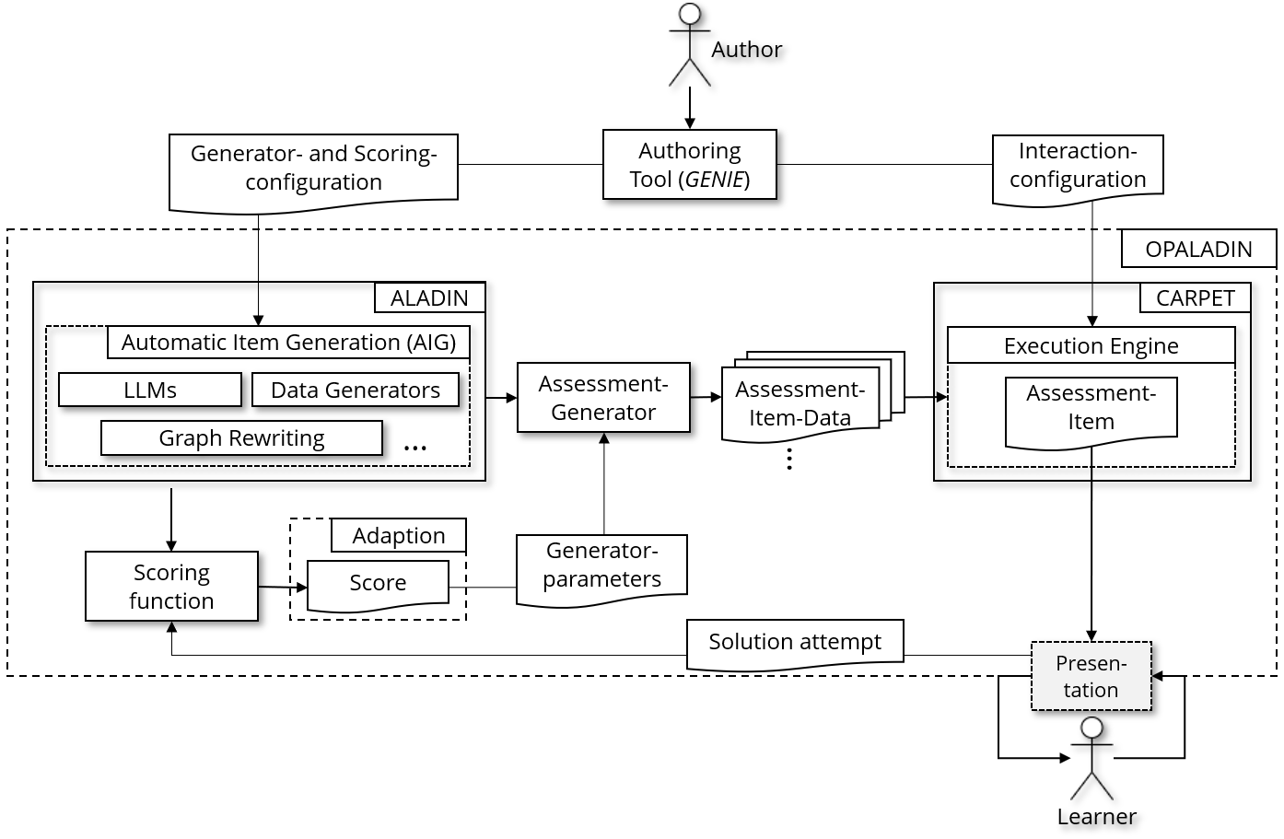
Outlook
G1
G5
G2
G3
G1 | Declarative usage (ideally by non-programmers).
G2 | Automatic adaption of assessment-complexity (based on user-history).
G3 | Automatic solution hints.
G4 | Accompanying studies to validate effectiveness.
G5 | Generation of semantically plausible assessments.
G4

Slide 16
Unterschiede in den Ansätzen
ALADIN
AIG-Toolkit ?
Generierung jeweils einer Aufgabe aus dem Möglichkeitsraum des Generators anhand von Parametern
„Bottom-Up“
Hauptsächlich graphenbasiert (grundsätzlich aber alles möglich)
Kein Autorentool vorhanden
Erstellung neuer Generatoren ist fachlich und technisch aufwendig
Darstellung über eigene UI
4R-Prinzip
Erweiterbar
Bildung aller (erlaubten) Kombinationen des Item-Modells und darauffolgendes „Ziehen“ aus Item-Satz
„Top-Down“
Ausschließlich Textaufgaben?
Autorentool vorhanden
Erstellung neuer Modelle ist nur fachlich aufwendig
Darstellung über existierende E-Assessment-Systeme (OPAL, ONYX) und Standards (QTI)

